Slide 1
Selected Topics in Computational Intelligence I
Session 5
Artificial Bee Colony
Session 5
Artificial Bee Colony

Slide 2
Agenda
Introduction Bee Colony Behavioral
Three Types Bees : Employee, Onlooker, scout\
ABC Algorithm
Sample Problem using ABC Algorithm

Slide 3
Introduction Bee Colony Behaviroal
Artificial Bee Colony (ABC) is one of the most recently defined algorithms by Dervis karaboga in 2005, motivated by the intelligent behaviour of honey bees.
ABC is developed based on inspecting the behaviors of real bees on finding nectar and sharing the information of food sources to the bees in the hive

Slide 4
BEHAVIOUR OF REAL BEES
Food sources:
its proximity to the nest
richness or concentration of energy
ease of extracting the energy
Employed bees:
provide information about food source
direction and distance from nest
profitability of the source

Slide 5
Onlooker bees
It gets the information of food sources from the employed bees and select one of the food source to gathers the nectar.
The Scout:
It is responsible for finding new food sources

Slide 6
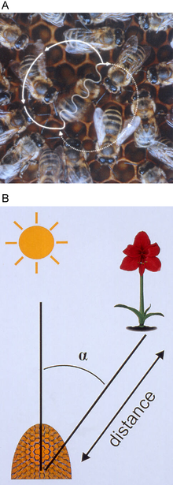

Bee colony behavioral
The forager learns from the other the location of the flower patch and can get the best of food source.
A waggle run oriented 45° to the right of ‘up’ on the vertical comb (A) indicates a food source 45° to the right of the direction of the sun outside the hive (B). The abdomen of the dancer appears blurred because of the rapid motion from side to side.

Slide 7
Types of foraging bee
Employed bees
Unemployed bees
 Scout
 Onlooker bees

Slide 10

Initial Solutions
Food source initialize
(Number of solutions = Employed bees)
Where
i = 1,2,…,n
n = Food source
j = Dimension

Slide 11

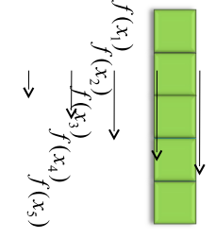
Employed Bee Phase
Send to each solutions (Can be done with Initial phase)
◦ Number of solutions = Employed bees
Calculate fitness

Slide 12
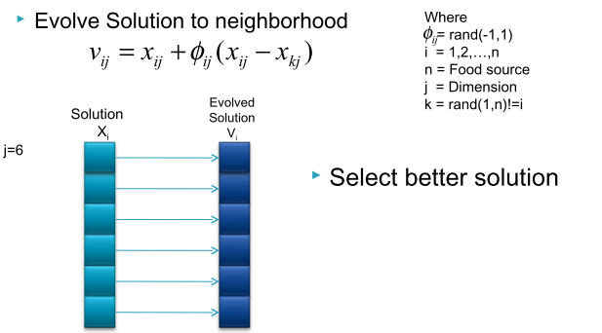
Employed Bee Phase

Slide 13

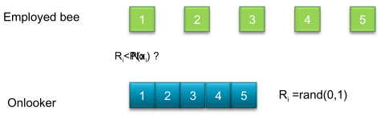
Onlooker Phase
Calculate probability for each solution
Select solution due to probability

Slide 14
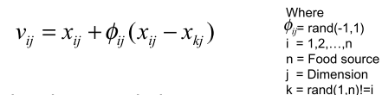
Onlooker Phase
Evolve Solution to neighborhood
Select better solution
(Same as Employed bee phase)

Slide 15
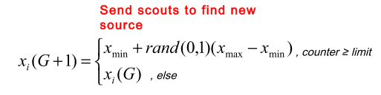
Send Scout
No of food source visited = “limit”

Slide 16
ABC Algorithm
Step 1 : Assign Control Parameters
Step 2 : Initialize Solutions
Step 3 : Repeat until criteria achieving
Send The employed bee and calculated fitness
Send the onlooker and calculate fitness
Send the scout bees
Memorize the best solution
Step 4 : Stop

Slide 17
Control Parameter
Swarm size
Employed bees(50% of swarm)
Onlookers(50% of swarm)
Scouts(1)
Limit
Dimension

Slide 18
Advantages and Disdavantages
Advantages
◦ Few control parameters
◦ Fast convergence
◦ Both exploration & exploitation
 Disadvantages
◦ Search space limited by initial solution (normal
distribution sample should use in initialize step)

Slide 19
Sample Problem
First, we initialize the positions of 3 food sources (CS/2) of
employed bees, randomly using uniform distribution in the range (-5, 5).
x = 1.4112 -2.5644
0.4756 1.4338
-0.1824 -1.0323
f(x) values are:
8.5678
2.2820
1.0990

Slide 20
Initial fitness vector is:
0.1045
0.3047
0.4764

Slide 21
Maximum fitness value is 0.4764, the quality of the best food source.
Cycle=1
Employed bees phase
1st employed bee
with this formula, produce a new solution.
k=1 k is a random selected index.
j=0 j is a random selected index.

Slide 22
Φ = 0.8050 Φ is randomly produced number in the range
[-1, 1].
υ0= 2.1644 -2.5644
Calculate f(υ0) and the fitness of υ0.
f(υ0) = 11.2610 and the fitness value is 0.0816.
Apply greedy selection between x0 and υ0
0.0816 < 0.1045, the solution 0 couldn’t be improved, increase
its trial counter.

Slide 23
2nd employed bee
with this formula produce a new solution.
k=2 k is a random selected solution in the neighborhood of i.
j=1 j is a random selected dimension of the problem.
Φ = 0.0762 Φ is randomly produced number in the range
[-1, 1].
υ1= 0.4756 1.6217
Calculate f(υ1) and the fitness of υ1.
f(υ1) = 2.8560 and the fitness value is 0.2593.
Apply greedy selection between x1 and υ1
0.2593 < 0.3047, the solution 1 couldn’t be improved, increase its trial counter.

Slide 24
3rd employed bee
with this formula produce a new solution.
k=0 //k is a random selected solution in the neighborhood
of i.
j=0 //j is a random selected dimension of the problem.
Φ = -0.0671 // Φ is randomly produced number in the range
[-1, 1].
υ2= -0.0754 -1.0323
Calculate f(υ2) and the fitness of υ2.
f(υ2) = 1.0714 and the fitness value is 0.4828.
Apply greedy selection between x2 and υ2.
0.4828 > 0.4764, the solution 2 was improved, set its trial
counter as 0 and replace the solution x2 with υ2.

Slide 25
x =
1.4112 -2.5644
0.4756 1.4338
-0.0754 -1.0323
f(x) values are;
8.5678
2.2820
1.0714
fitness vector is:
0.1045
0.3047
0.4828

Slide 26
Calculate the probability values p for the solutions x by means of their fitness values by using the formula;
p = 0.1172
0.3416
0.5412

Slide 27
Onlooker bees phase
Produce new solutions υi for the onlookers from the
solutions xi selected depending on pi and evaluate them.
1st onlooker bee
i=2
υ2= -0.0754 -2.2520
Calculate f(υ2) and the fitness of υ2.
f(υ2) = 5.0772 and the fitness value is 0.1645.
Apply greedy selection between x2 and υ2
0.1645 < 0.4828, the solution 2 couldn’t be improved, increase its trial counter.

Slide 28
2nd onlooker bee
i=1
υ1= 0.1722 1.4338
Calculate f(υ1) and the fitness of υ1.
f(υ1) = 2.0855 and the fitness value is 0.3241.
Apply greedy selection between x1 and υ1
0.3241 > 0.3047, the solution 1 was improved, set its trial counter as 0 and replace the solution x1 with υ1.

Slide 29
x =
1.4112 -2.5644
0.1722 1.4338
-0.0754 -1.0323
f(x) values are
8.5678
2.0855
1.0714
fitness vector is:
0.1045
0.3241
0.4828

Slide 30
3rd onlooker bee
i=2
υ2= 0.0348 -1.0323
Calculate f(υ2) and the fitness of υ2.
f(υ2) = 1.0669 and the fitness value is 0.4838.
Apply greedy selection between x2 and υ2
0.4838 > 0.4828, the solution 2 was improved, set its trial
counter as 0 and replace the solution x2 with υ2.

Slide 31
x =
1.4112 -2.5644
0.1722 1.4338
0.0348 -1.0323
f(x) values are
8.5678
2.0855
1.0669
fitness vector is:
0.1045
0.3241
0.4838

Slide 32
Memorize best
Best = 0.0348 -1.0323
Scout bee phase
Trial Counter =
1
0
0
There is no abandoned solution since L = 6
If there is an abandoned solution (the solution of which the
trial counter value is higher than L = 6);
Generate a new solution randomly to replace with the
abandoned one.
Cycle = Cycle+1
The procedure is continued until the termination criterion is
attained.

Slide 40
References
Enterprise Architecture at Work Modelling, Communication and Analysis,: Lankhorst, Marc
How to Survive in the Jungle of Enterprise Architecture Frameworks: Creating or Choosing an Enterprise Architecture Framework, Jaap Schekkerman
An Introduction to Enterprise Architecture: Third Edition, Scott A. Bernard, AuthorHouse

